Slide 1


BRITISH AIRWAYS
Data Science Internship
Under the Guidance of
Dr. D. VIVEK, ASSOCIATE PROFESSOR
COMPUTER SCIENCE AND ENGINEERING
B.V.RAJU INSTITUTE OF TECHNOLOGY, Narsapur
Presented by
NAGAVALLI SAI SAKETH, 20211A05J6

Slide 2
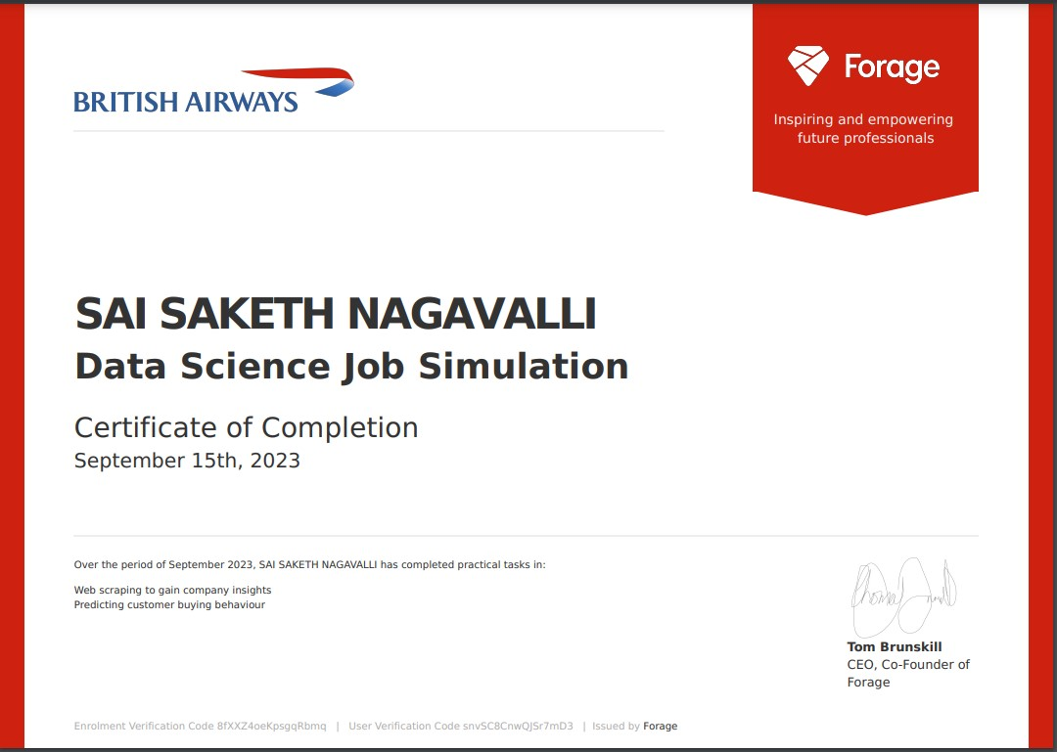
Proof of Internship
Proof of Internship
Introduction
Software Tools
Implemented Tasks/Modules
Flow chart of Carried Tasks/Modules
Screen shots of Tasks/Modules
References
September
Data Science
Virtual
Projects

Slide 3
Proof of Internship
Introduction
Software Tools
Implemented Tasks/Modules
Flow chart of Carried Tasks/Modules
Screen shots of Tasks/Modules
References
Abstract
Introduction
Existing System
Proposed System
Software requirements
Architecture Model
Modules
UML Diagrams/ER Diagrams/Flow Charts
References
Introduction
British Airways (BA), the prestigious flag carrier airline of the United Kingdom, plays a pivotal role in connecting passengers from all corners of the globe.
In this dynamic aviation landscape, data science emerges as a powerful tool to optimize operations, drive decision-making, and enhance customer satisfaction.
As a data scientist at British Airways, the task at hand is both ambitious and transformative. It involves the collection, analysis, and interpretation of customer feedback gathered from various sources.
This invaluable feedback not only reflects the sentiments, needs, and experiences of our passengers but also holds the key to improving service quality and making data-driven decisions.
The success of predictive models hinges on the quality of the data used to train machine learning algorithms.
In this project, our goal is to manipulate and prepare the customer booking data provided to create a high-quality predictive model. This model will enable us to gain insights into customer behavior and make informed decisions about marketing strategies and product offerings.

Slide 4
Proof of Internship
Introduction
Software Tools
Implemented Tasks/Modules
Flow chart of Carried Tasks/Modules
Screen shots of Tasks/Modules
References
Abstract
Introduction
Existing System
Proposed System
Software requirements
Architecture Model
Modules
UML Diagrams/ER Diagrams/Flow Charts
References
Introduction
PURPOSE :
Scrape and collect customer feedback by analysing third-party data
Prepare a dataset
Train a machine learning model
Evaluate and present your findings
MOTIVATION :
In a competitive aviation industry, data-driven decision-making is not just an advantage; it's a necessity. By leveraging data science, we can not only improve customer satisfaction but also drive cost efficiencies and increase revenue.
By embracing predictive analytics, we can position ourselves as a forward-thinking airline, ready to engage with customers at the right moment with the right offerings.
OBJECTIVE :
Gather customer feedback data , Analyze the collected data, Generate actionable insights and recommendations, Develop data-driven tools and models
Prepare and manipulate the provided customer booking data, Develop and fine-tune predictive machine learning algorithms , Evaluate the performance of the predictive model, Interpret the results , Provide actionable recommendations

Slide 5
Introduction
Existing System
Proposed System
Software requirements
References
Proof of Internship
Introduction
Software Tools
Implemented Tasks/Modules
Flow chart of Carried Tasks/Modules
Screen shots of Tasks/Modules
References
Software Tools
  Web Scraping : Beautifulsoup, Scrapy
  Language : Python
  IDE : Jupyter Notebook, Google Colab
  Libraries :NLTK, Pandas, Numpy
  Visualization Tools : Matplotlib, Seaborn, WordCloud
  Algorithms : RandomForest, XGBoost

Slide 6
Introduction
Existing System
Proposed System
Software requirements
References
Proof of Internship
Introduction
Software Tools
Implemented Tasks/Modules
Flow chart of Carried Tasks/Modules
Screen shots of Tasks/Modules
References
Implemented Tasks/Modules
Task-1 :Web scraping to gain company insights
Scrape data from the web
Analyse data
Present insights
Task-2 :Predicting customer buying behaviour
Explore and prepare the dataset
Train a machine learning model
Evaluate model and present findings

Slide 7
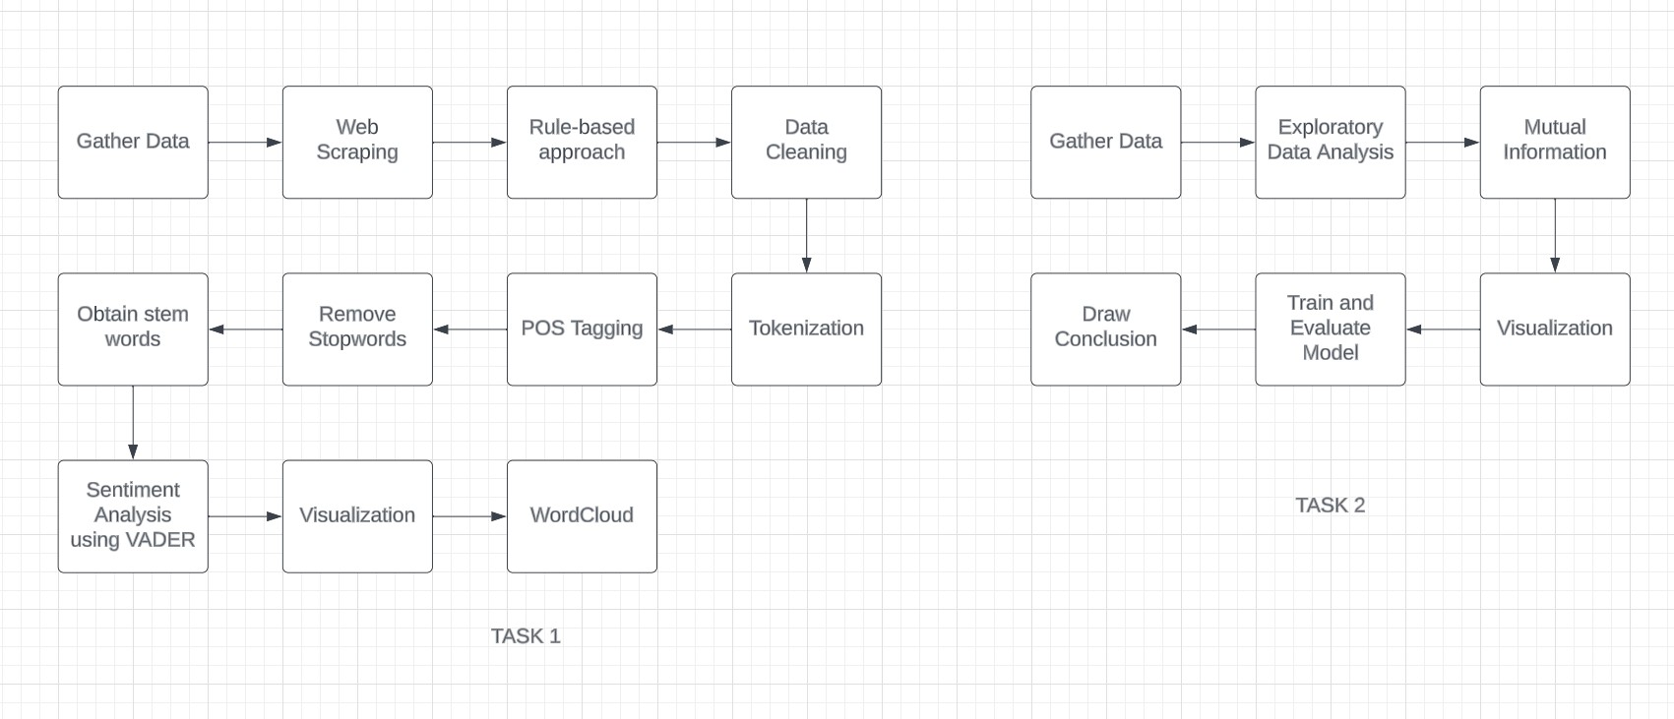
Introduction
Existing System
Proposed System
Software Requirements
References
Proof of Internship
Introduction
Software Tools
Implemented Tasks/Modules
Flow chart of Carried Tasks/Modules
Screen shots of Tasks/Modules
References
Flow chart of Carried Tasks/Modules
DATA FLOW DIAGRAM (DFD)

Slide 8
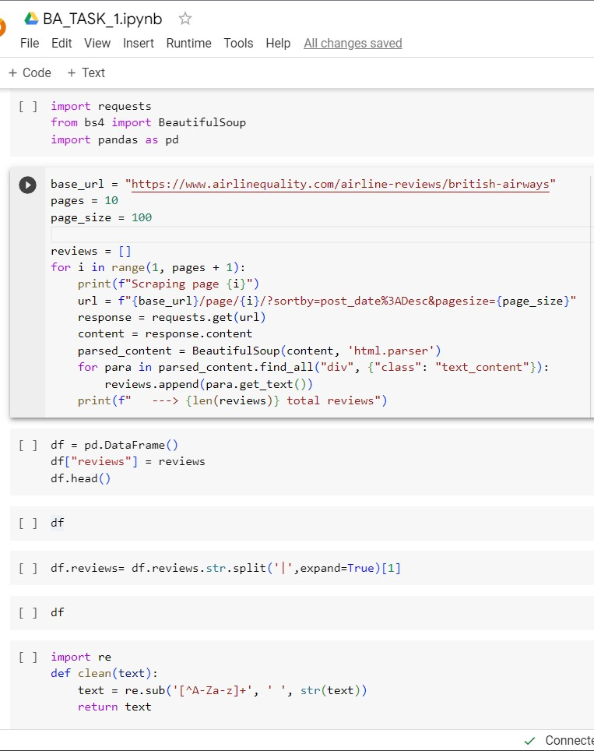
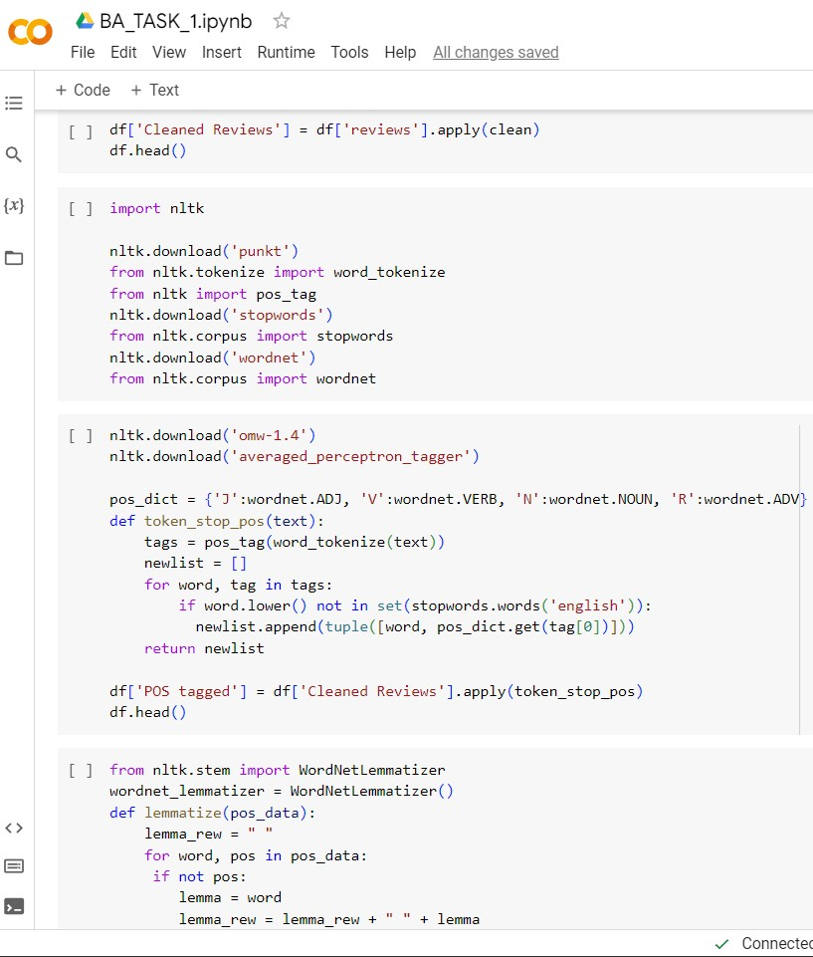
Screen shots of Tasks/Modules
Proof of Internship
Introduction
Software Tools
Implemented Tasks/Modules
Flow chart of Carried Tasks/Modules
Screen shots of Tasks/Modules
References

Slide 9
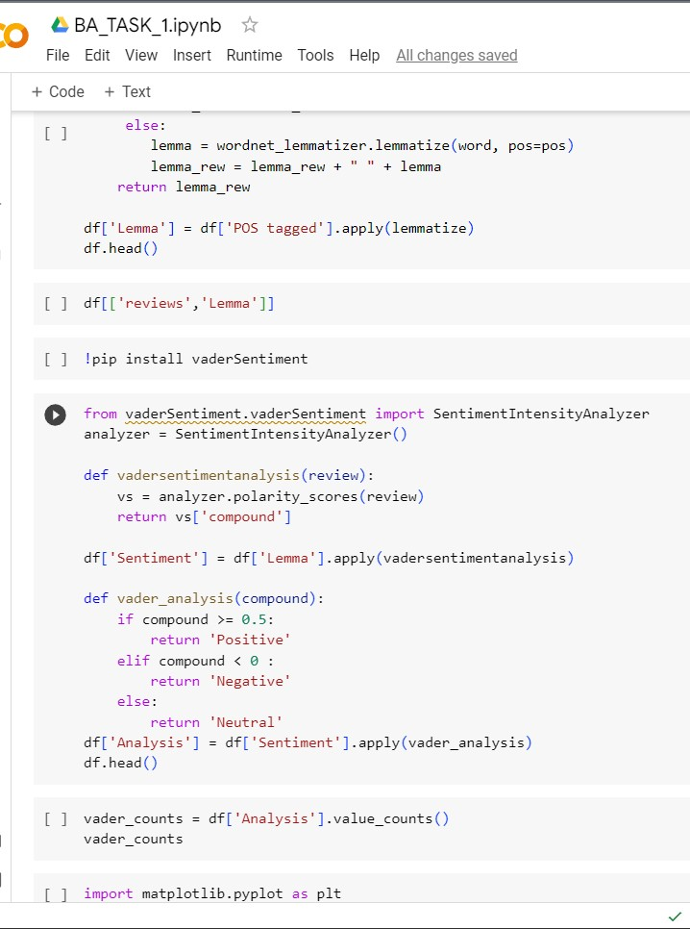
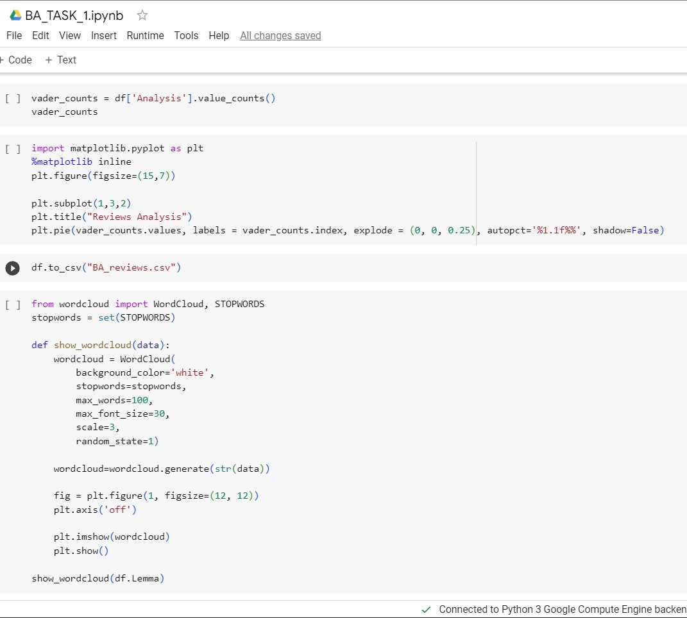
Screen shots of Tasks/Modules
Proof of Internship
Introduction
Software Tools
Implemented Tasks/Modules
Flow chart of Carried Tasks/Modules
Screen shots of Tasks/Modules
References

Slide 10
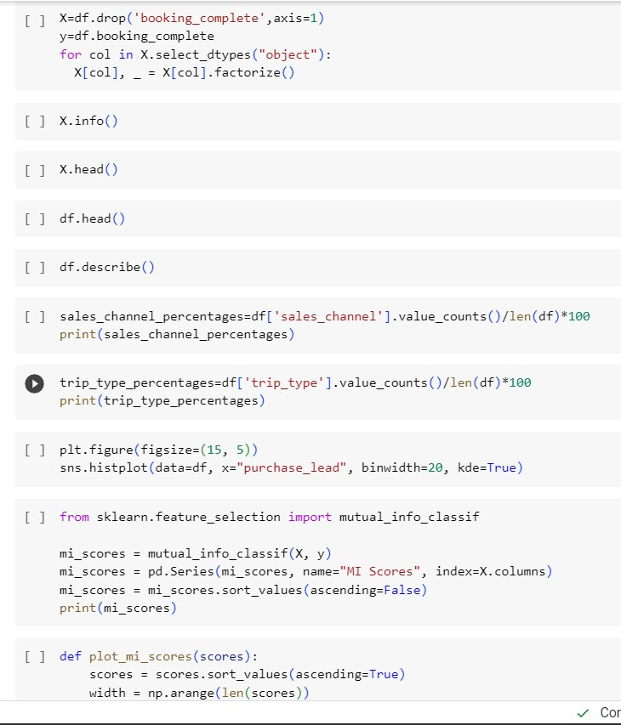
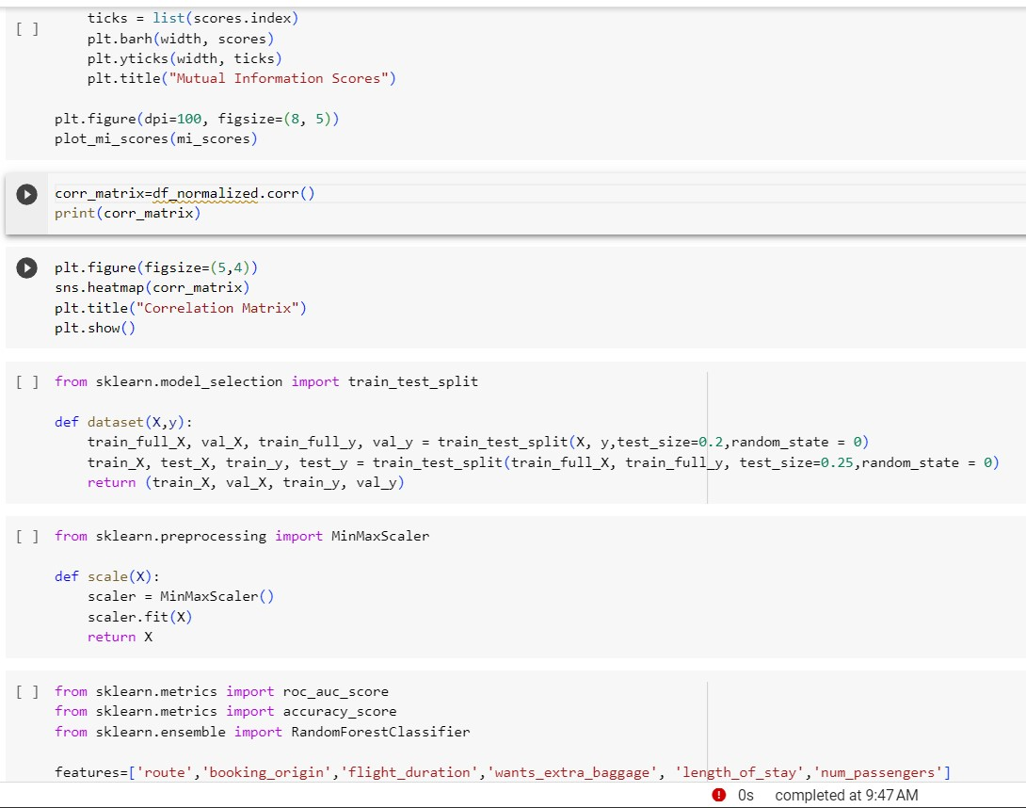
Screen shots of Tasks/Modules
Proof of Internship
Introduction
Software Tools
Implemented Tasks/Modules
Flow chart of Carried Tasks/Modules
Screen shots of Tasks/Modules
References

Slide 11
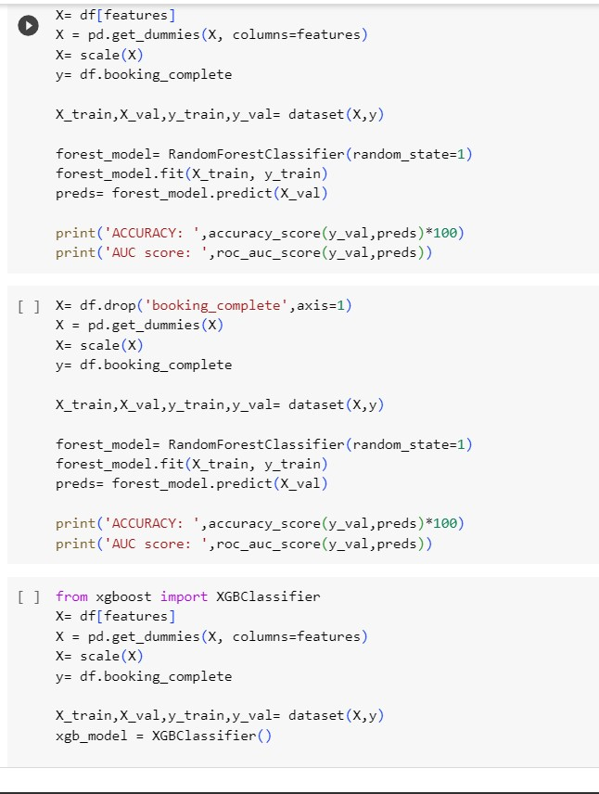
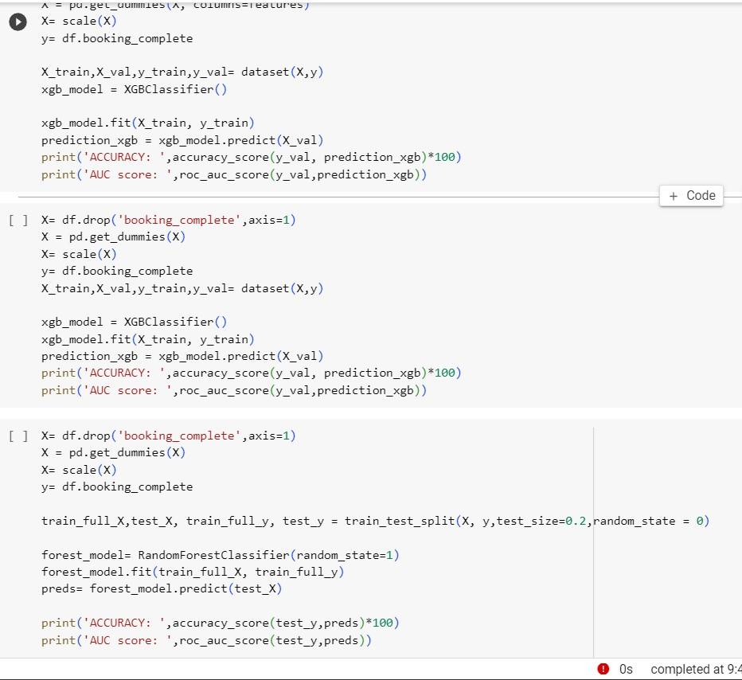
Screen shots of Tasks/Modules
Proof of Internship
Introduction
Software Tools
Implemented Tasks/Modules
Flow chart of Carried Tasks/Modules
Screen shots of Tasks/Modules
References

Slide 12
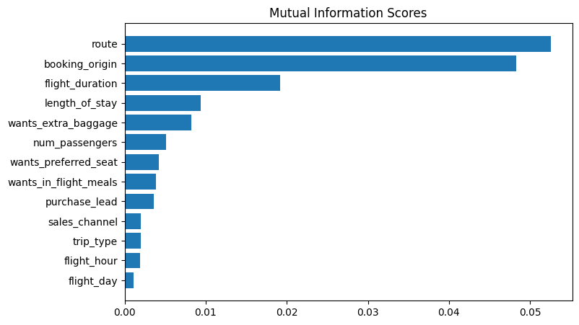
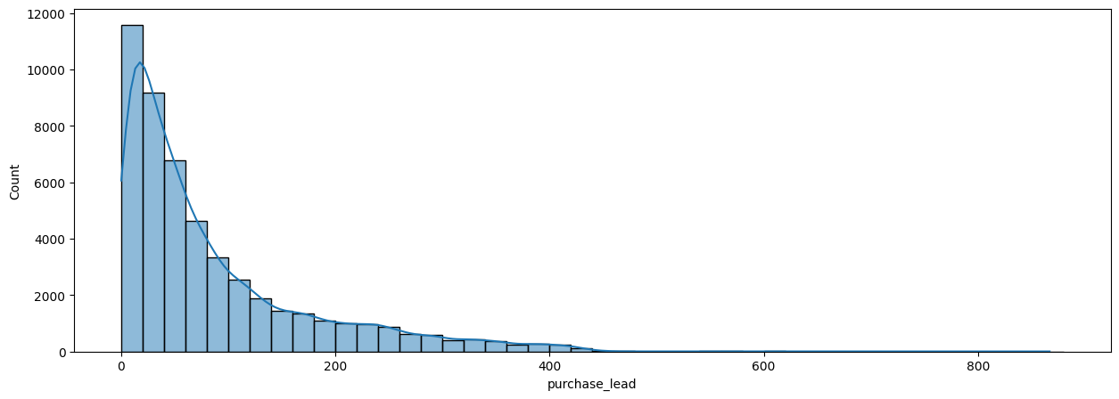
Screen shots of Tasks/Modules
Proof of Internship
Introduction
Software Tools
Implemented Tasks/Modules
Flow chart of Carried Tasks/Modules
Screen shots of Tasks/Modules
References
We have trained the data set with Random forest classifier model and received
ACCURACY: 85.37
AUC score: 0.568
route
booking_origin
flight_duration
wants_extra_baggage
length_of_stay
are the top 5 features which influence
Customer buying behavior

Slide 13
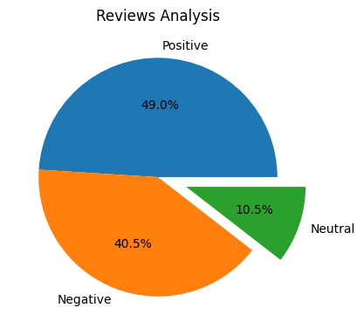
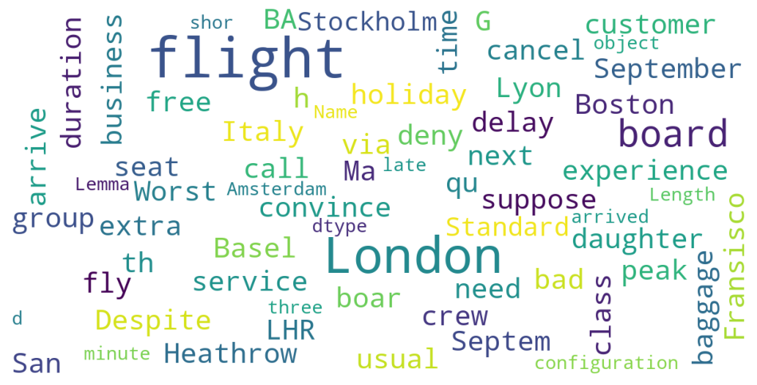
Screen shots of Tasks/Modules
Proof of Internship
Introduction
Software Tools
Implemented Tasks/Modules
Flow chart of Carried Tasks/Modules
Screen shots of Tasks/Modules
References
From cleaning 1000 reviews given by the customers, we obtained
Positive Reviews - 490
Negative Reviews - 405
Neutral Reviews – 105
Word cloud of keywords used in reviews

Slide 14
References
Proof of Internship
Introduction
Software Tools
Implemented Tasks/Modules
Flow chart of Carried Tasks/Modules
Screen shots of Tasks/Modules
References
For Web Links:
[1].Forage
For Organization Specific Links:
[2].Britishairways
For Tasks Specific
[3]. Skytrax

Slide 15
Thank you
Any Questions?

